Slide 1
TABLE OF CONTENTS
LITERATURE REVIEW
PROBLEM STATEMENT
MATERIAL REQUIRED
IDENTIFICATION OF ESSENTIAL CONCEPTS
USEFULNESS TO SOCIETY
PROJECT SCHEDULING & WORK DELEGATION
COMPLIANCE TO STANDARDS
EFFECTIVE UTILIZATION OF THE MODERN TOOLS
DESIGN OF THE MODEL
RUNNING OF PROGRAM
BUDGET ANALYSIS
REFRENCE
E LINK

Slide 2
LITERATURE REVIEW
Inertial guidance systems were originally developed for rockets. American rocket pioneer Robert Goddard experimented with rudimentary gyroscopic systems. Dr. Goddard's systems were of great interest to contemporary German pioneers including Wernher von Braun. The systems entered more widespread use with the advent of spacecraft, guided missiles, and commercial airliners.
The earliest examples of a true guidance system is that used in the German V-1 during World War II. The navigation system consisted of a simple gyroscope, an airspeed sensor, and an altimeter. The guidance instructions were target altitude, target velocity, cruise time, and engine cut off time.
A guidance system has three major sub-sections: Inputs, Processing, and Outputs. The input section includes sensors, course data, radio and satellite links, and other information sources. The processing section, composed of one or more CPUs, integrates this data and determines what actions, if any, are necessary to maintain or achieve a proper heading. This is then fed to the outputs which can directly affect the system's course. The outputs may control speed by interacting with devices such as turbines, and fuel pumps, or they may more directly alter course by actuating ailerons, rudders, or other devices.

Slide 3


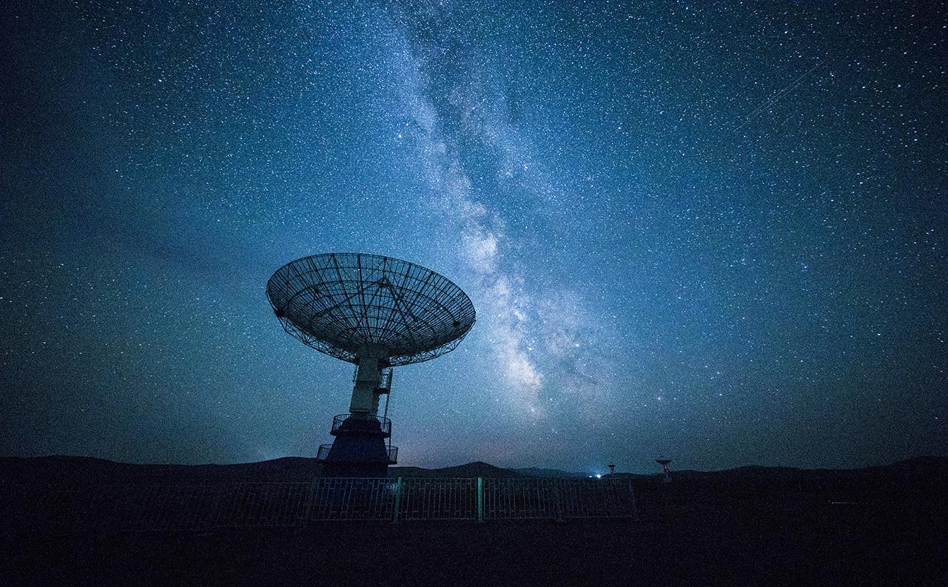
LITERATURE REVIEW
GNC systems and related technologies and engineering have always been part of our company's core competencies. Currently, GMV's GNC Division is one of the biggest and best in the whole European space industry. The know-how and expertise have been built up over many years of continuous learning and application to a significant number of GNC related technological activities for ESA and to a growing number of ESA missions, such as PROBA-3, IXV, Mars Sample Return, Lunar Lander and others.
Designing a GNC system requires a very complete and iterative process, that usually comprises a set of different disciplines and requires the involvement of a team made up of people with different background knowledge and education, including: mission design and planning, S/C systems knowledge, trajectory design, control design, sensor technology, navigation strategy and navigation filters design, on-board SW coding, SW verification and system verification (including HW in the loop). This challenge has always been and still is exciting while pushing us towards innovation and self-improvement, which have made GMV a key player in the GNC field in Europe.

Slide 4
S.NO. | AUTHOR | YEAR | JOURNALS | WORK
01 | Grewal, Mohinder S; Weill, Lawrence R. (Lawrence Randolph), 1938-; Andrews, Angus P | 1938 | Global positioning systems, inertial navigation, and integration | US guidance history centers around 2 distinct communities. One driven out of Caltech and NASA Jet Propulsion Laboratory, the other from the German scientists that developed the early V2 rocket guidance and MIT. The GN&C system for V2 provided many innovations and was the most sophisticated military weapon in 1942 using self-contained closed loop guidance. Early V2s leveraged 2 gyroscopes and lateral accelerometer with a simple analog computer to adjust the azimuth for the rocket in flight. Analog computer signals were used to drive 4 external rudders on the tail fins for flight control. Von Braun engineered the surrender of 500 of his top rocket scientists, along with plans and test vehicles, to the Americans. They arrived in Fort Bliss, Texas in 1945 and were subsequently moved to Huntsville, Al in 1950 (aka Redstone arsenal)
02 | Scharf, D. P., Hadaegh, F. Y., and Ploen, S. R | 2003 | A Survey of Spacecraft Formation Flying Guidance and Control (Part 1): Guidance | The main challenge related to spacecraft FF missions is the design of robust and reliable guidance, navigation, and control (GNC) techniques for onboard systems. Thus, the intent of this paper is to determine the state of the art of the onboard GNC system in terms of hardware/software solutions and achievable performances through a comprehensive survey of past, current, and future FF missions. Many past works focused on the review of the research status of GNC techniques.
03 | Bandyopadhyay, S., Subramanian, G. P., and Foust, R | 2015 | A Review of Impending Small Satellite Formation Flying Missions | an analysis of the onboard GNC systems, investigating the required/achieved performances, the functional architecture, and the onboard hardware, appears to not be available in the literature except for a specific class of spacecraft, i.e., the small satellites

Slide 5
S.NO. | AUTHOR | YEAR | JOURNALS | WORK
04 | Llorente, J. S., Agenjo, A., Carrascosa, C., de Negueruela, C., Mestreau-Garreau, A., Cropp, A., and Santovincenzo, A | 2013 | PROBA-3: Precise Formation Flying Demonstration Mission,”Acta Astronautica | The Canadian Advanced Nanosatellite experiment-4 and -5 (CanX-4&5; see Sec. II.C.4) or the Project for On-Board Autonomy-3 (PROBA-3) [4], are planned to be launched to test technologies for autonomous proximity operations. In fact, a completely autonomous system guarantees superior performance in terms of control accuracy and higher mission flexibility/adaptability, providing a prompt response to contingencies. Moreover, onboard autonomy allows performing maneuvers far from Earth, overcoming problems due to large communication delays, and reducing the operations costs
05 | Buchen, E | 2014 | SpaceWorks’2014 Nano/Microsatellite Market Assess- ment | Onboard autonomy allows performing maneuvers far from Earth, overcoming problems due to large communication delays, and reducing the operations costs. This need for autonomy presents a new set of challenges in the areas of onboard sensing, actuation, and maneuver planning, as well as in mission management and scheduling; monitoring; and fault detection, isolation, and recovery (FDIR)
06 | Agasid, E., Burton, R., Carlino, R., Defouw, G., Dono Perez, A., Karacahoglu, A. G., Klamm, B., Rademacher, A., Schalkwyck, J., Shimmin, R., Tilles, J., and Weston, S. | 2015 | Small Spacecraft Technology State of the Art | The use of small satellites (mass lower than 500 kg), especially nano- and microsatellites (see Table 1), is growing tremendously in the space field, thanks to the development and wide use of the CubeSat standard and all related technology equipment [5,6]. As an immediate consequence, small satellites have been increasingly proposed to build up distributed space systems for Earth observation and science purposes

Slide 6
PROBLEM STATEMENT
Improving the guidance, navigation and control of missile for hitting target accurately and precisely by increasing the stability with avoiding any obstacle in path.

Slide 7
MATERIALS REQUIRED
ARDUINO
SERVOMOTOR
DIGITAL GYROSCOPE SENSOR
BATTERY
LAUNCH PAD
JUMPER WIRE
ROCKET MODEL
SOLID ROCKET MOTOR

Slide 8
IDENTIFICATION OF ESSENTIAL CONCEPTS
Advance in MATLAB and Simulink
Basic knowledge of FlightGear.
Extensive Knowledge of GN&C subject with Rocket Propulsion
S/C systems knowledge, trajectory design, control design, sensor technology, navigation strategy and navigation filters design.

Slide 9
USEFULNESS TO SOCIETY
For defence purpose in order to retaliate when there is attack from other nation.
Since the project is for improving the accuracy for hitting the target which also considers safety and security of the surrounding area.
This will help increase in export of the new technologies which will help in growth of economy. This project will also head the nation towards being self reliant encouraging 'Make in India'.
The innovation and development in the field will open new opportunities and encourage the young minds to explore more.
Having improved technologies will increase influence on the rival countries.

Slide 10
PROJECT SCHEDULING & WORK DELEGATION
ON PAPER CALCULATION AND FORMULATION
(05 FEB 2021)
STUDY OF CONCEPTS FROM REFERENCES
(FROM 15 JAN 2021)
PROGRAMMING in MATLAB
(20 FEB 2021)
SIMULATION in FLIGHTGEAR and STK SOFTWARE
(10 MAR 2021)
FABRICATION of MISSILE
(20 MAR-APRIL 2021)

Slide 11
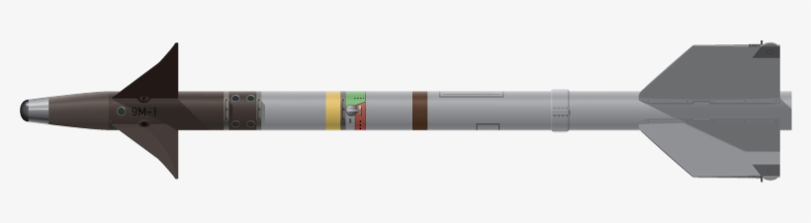
COMPLIANCE TO STANDARDS
We took standard from AIM-9M missile
Dimension
Alternate names : PJ-10
Length : 3.02 m
Originated from : United States of America
Diameter : 127mm
Launch weight : 85.3 kg
Warhead mass : 9.4 kg
Maximum velocity : Mach 2.5-2.8
Maximum range : 35.4 km
Basing : Ground-launched, Air-launched, Ship-launched, fixed launchers
Propulsion : Solid fuel rocket

Slide 12
EFFECTIVE UTILIZATION OF MODERN TOOLS
THE TOOLS USED FOR DEMONSTRATION AND OPERATION OF THE MODELED MISSILE ARE:
CATIA V5: FOR MODELLING
MATLAB SIMULINK: FOR PROGRAMMING
FLIGHTGEAR: FOR SIMULATION

Slide 13
SOFTWARE ANALYSIS
THE PROCEDURE INVOLVED
CREATION OF MODEL OF AIM-9M MISSILE IN CATIA V5
Creating program in matlab simulink to control
Importing model to flightgear for simulation.

Slide 14
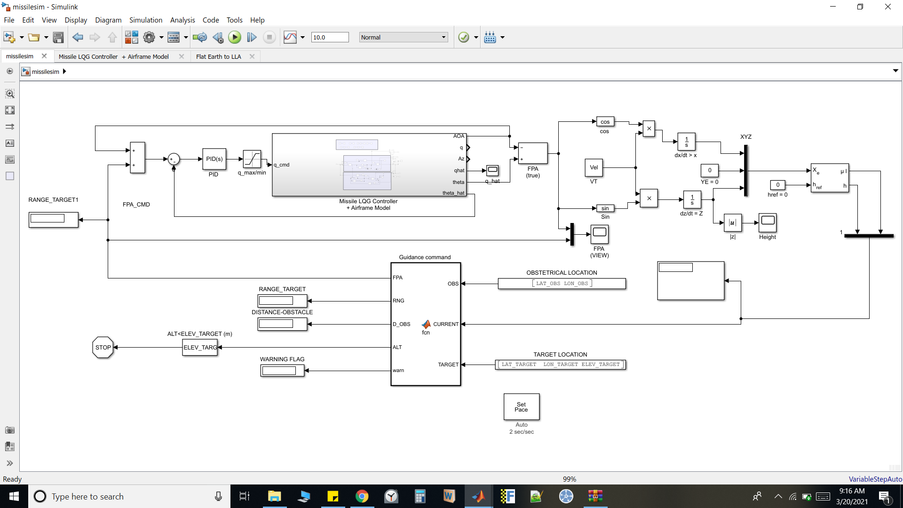
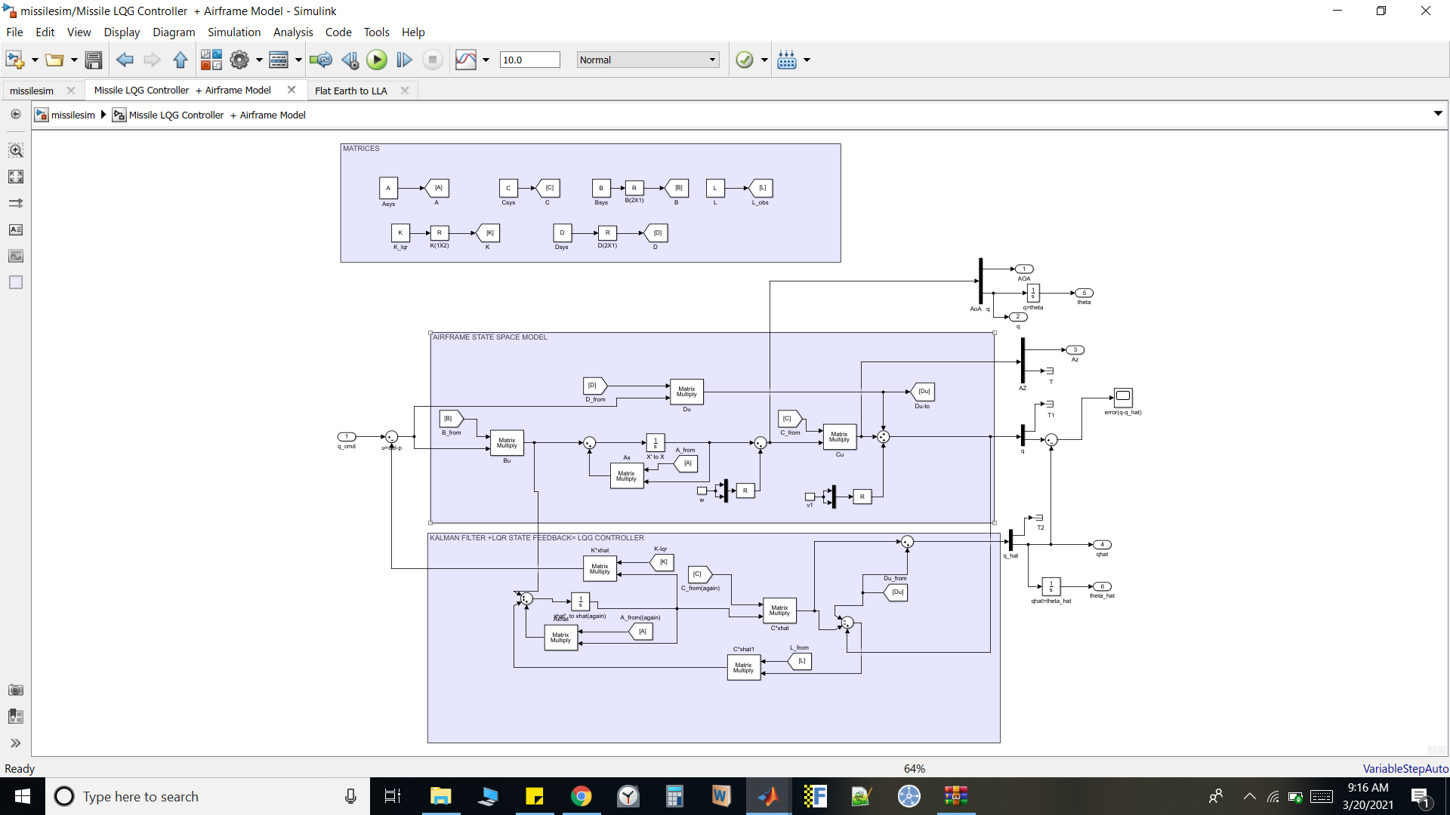
PROGRAM ON MATLAB SIMULINK

Slide 15
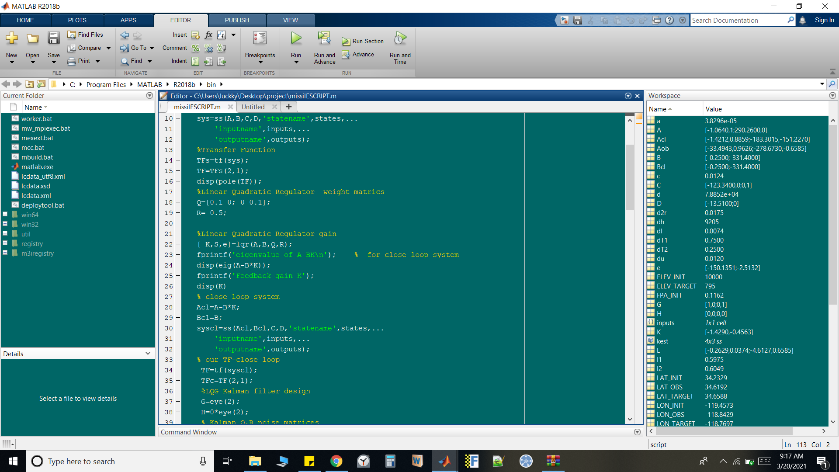

SCRIPT OF THE PROGRAM

Slide 16
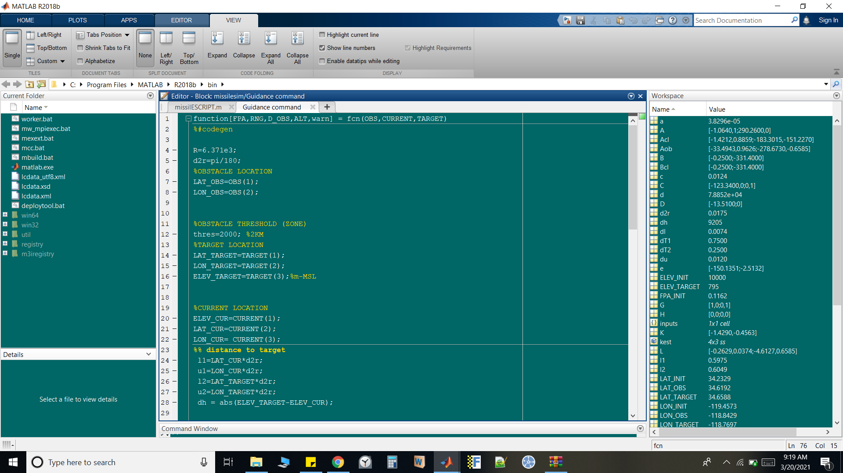
GUIDANCE PROGRAM

Slide 17
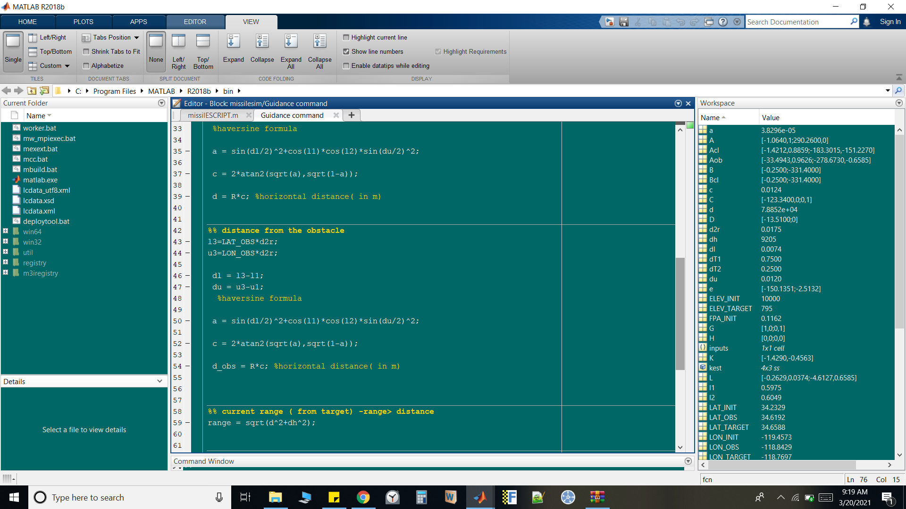
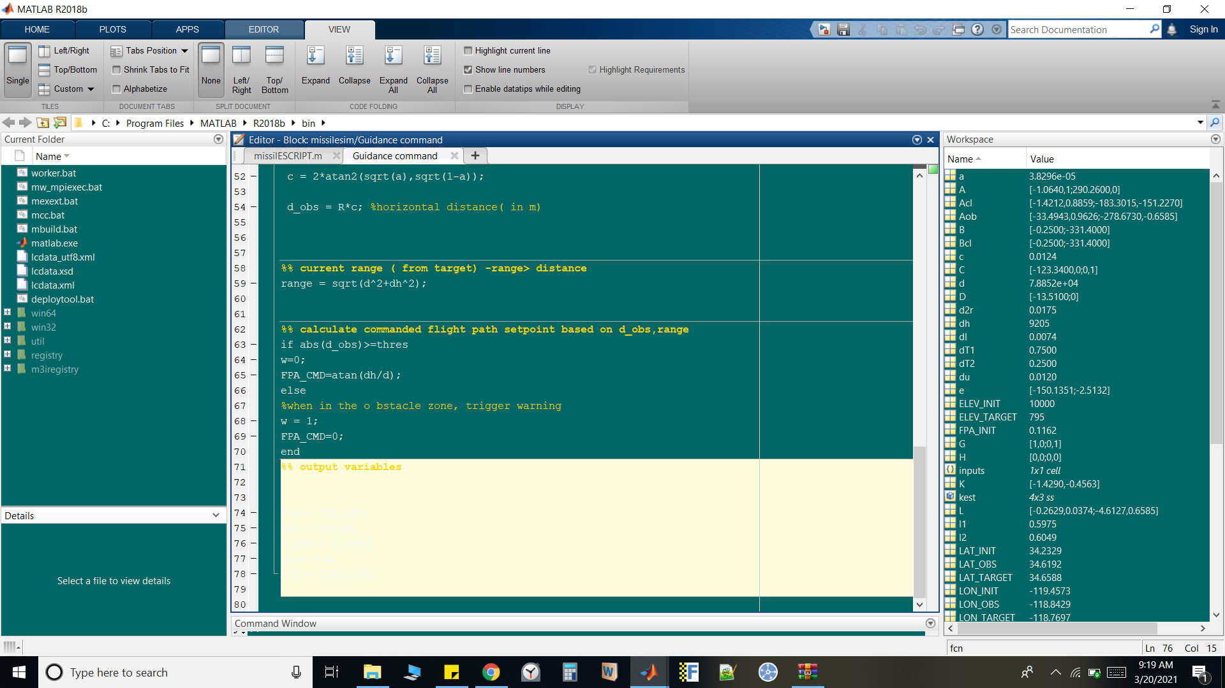

Slide 18
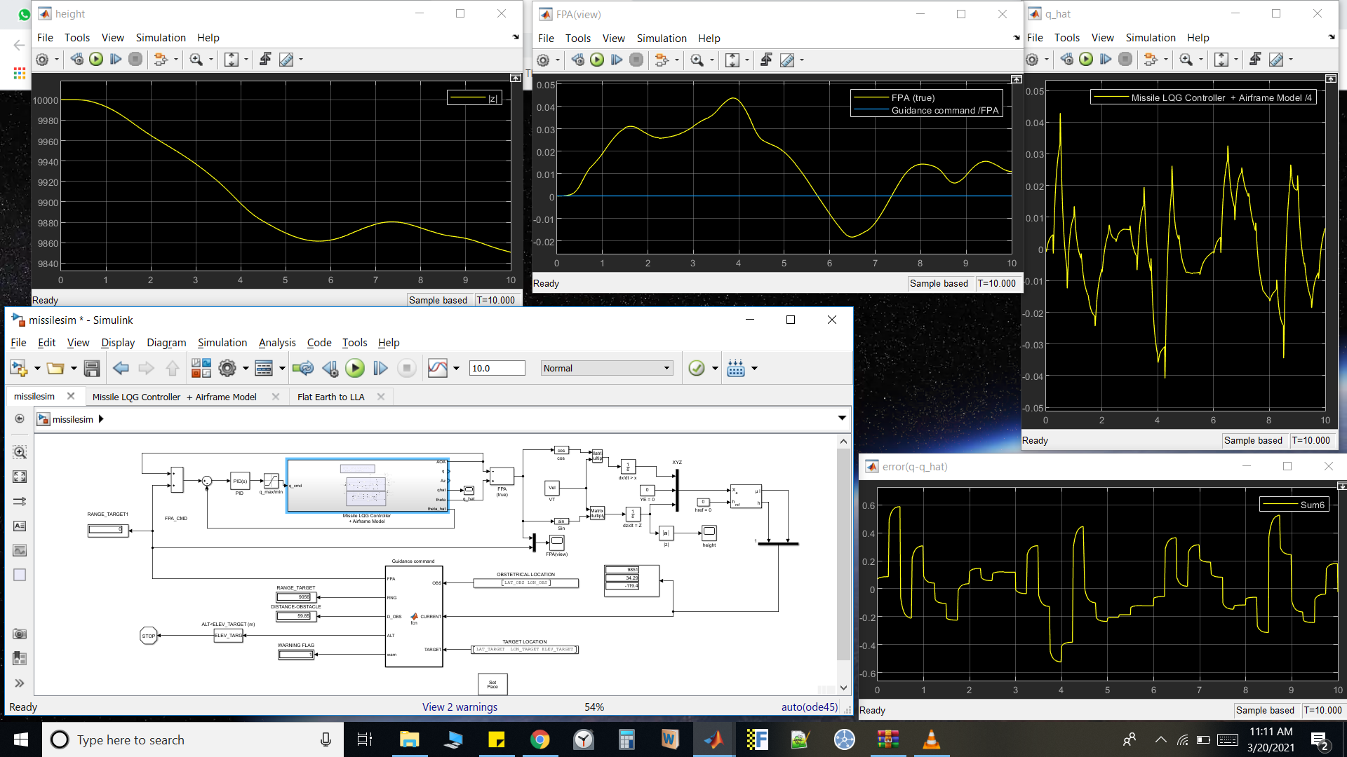
CONTD.

Slide 19
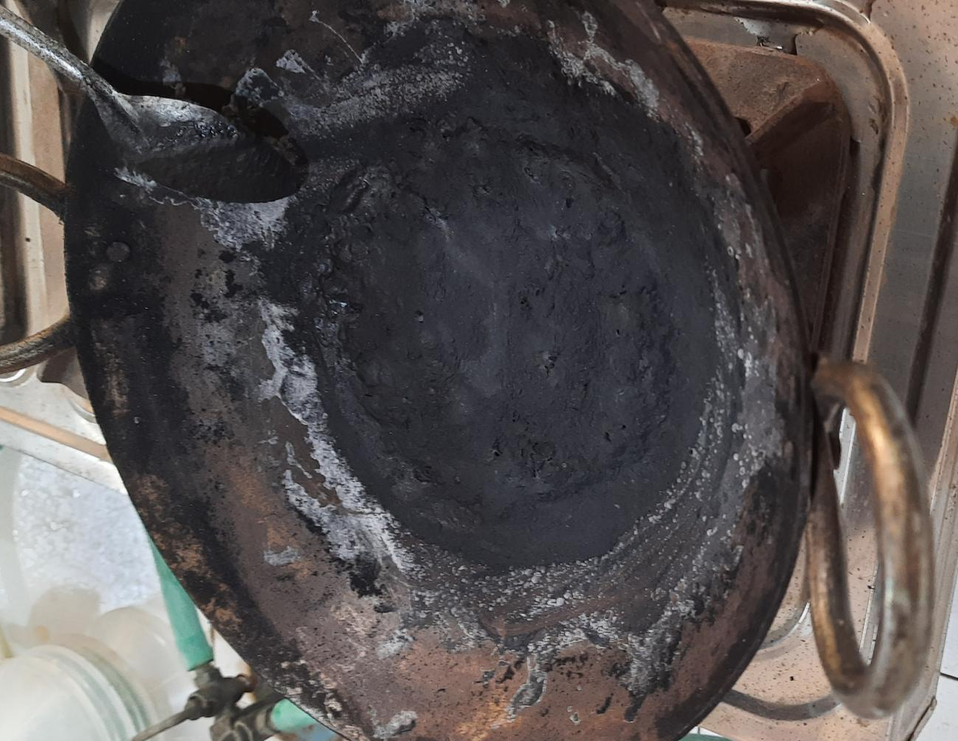
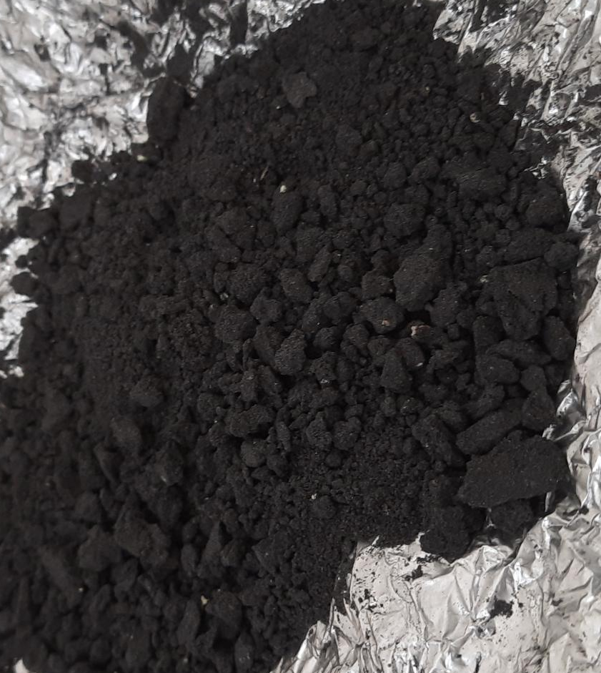
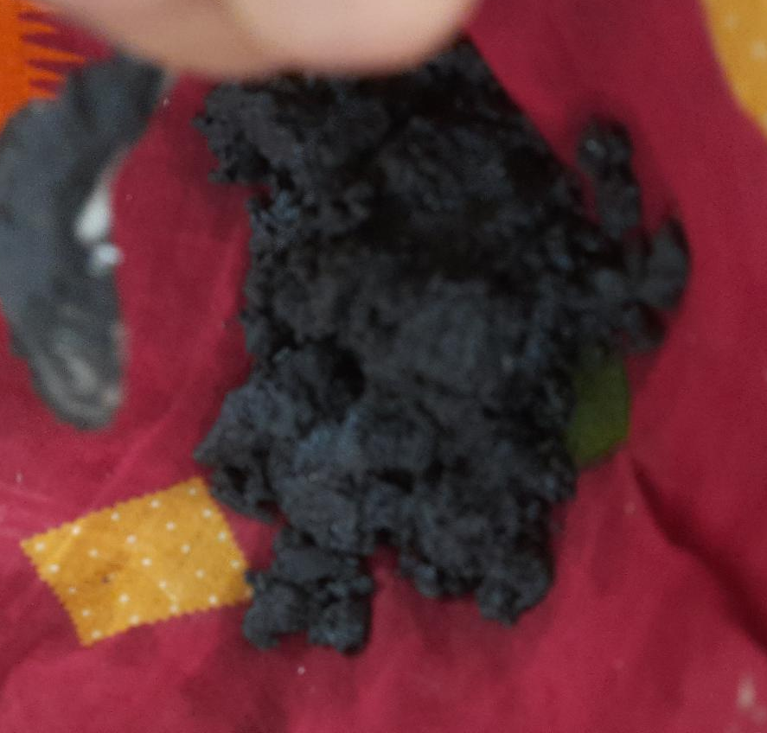
MAKING OF BLACK POWDER AS THE SOLID ROCKET PROPELLANT
chemicals required:
charcoal
sulphur
potassium nitrate
ethyl alcohol
apparatus required
pistil and mortar
heating equipment
measuring apparatus
cloth
aluminium foil

Slide 20
BUDGET ANALYSIS
MATERIAL | COST
KNO3 (POTASSIUM NITRATE) | 600
SULPHUR POWDER | 300
AVIONICS EQUIPMENTS | 700
CABLES | 150
MODEL PROTOTYPE | 1000
3D PRINTING OF FIN | 2000
OTHERS | 500
TOTAL (APPROX) | 6000

Slide 21
REFRENCE
Grewal, Mohinder S.; Weill, Lawrence R.; Andrews, Angus P. (2007). Global Positioning Systems, Inertial Navigation, and Integration (2nd ed.). Hoboken, New Jersey, USA: Wiley-Interscience, John Wiley & Sons, Inc. p. 21. ISBN 978-0-470-04190-1.
Farrell, Jay A. (2008). Aided Navigation: GPS with High Rate Sensors. USA: The McGraw-Hill Companies. pp. 5 et seq. ISBN 0-07-164266-8.
Draper, C. S.; Wrigley, W.; Hoag, G.; Battin, R. H.; Miller, E.; Koso, A.; Hopkins, A. L.; Vander Velde, W. E. (June 1965). Apollo Guidance and Navigation (PDF) (Report). Massachusetts: Massachusetts Institute of Technology, Instrumentation Laboratory. pp. I-3 et seqq.
Curtis P. Mracek; D. Brett Ridgely. raytheon missile systemsQ “Missile Longitudinal Autopilots: Connections Between Optimal Control and Classical Topologies”

Slide 22
E LINK
https://www.researchgate.net/publication/321539579_Survey_on_Guidance_Navigation_and_Control_Requirements_for_Spacecraft_Formation-Flying_Missions
https://archive.org/details/globalpositionin00grew_526
https://www.nasa.gov/sites/default/files/atoms/files/gnc.pdf
https://youtu.be/vxzR3W2BcRk
https://youtu.be/0AJ6E48Aj9U
https://youtu.be/wrr-QZxX4Og (MAKING BLACK POWDER)

Slide 23
THANK YOU

